Slide 1
Sugon Severs Rack Servers
Moscow, 12/2015

Slide 2
Agenda
1
Product Line Overview
2
2 Way Rack Server
3
Mission Critical Servers
4
Personalize Services
Notes:
先讲整个IT行业的大背景

Slide 3
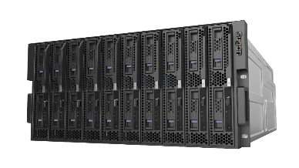
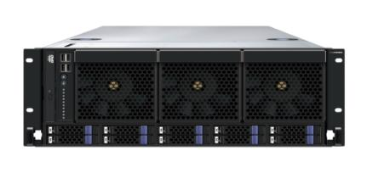
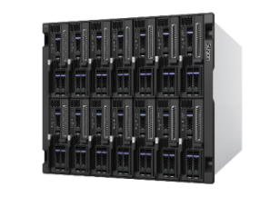
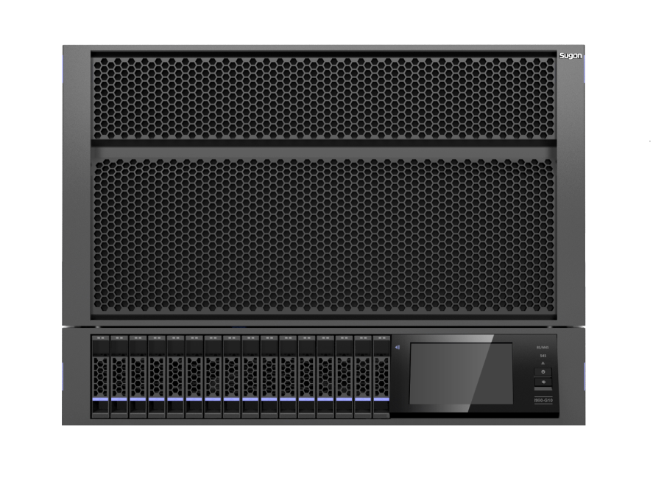
Server Product Line
Industry Standard
Rack Server
Mission Critical
Rack Server
Blade Server
High Density
Module
RAS
Fusion
Powerful

Slide 4
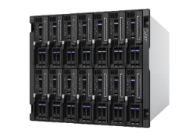
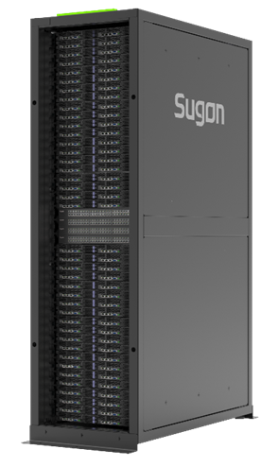
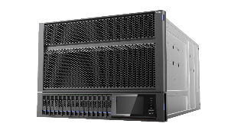
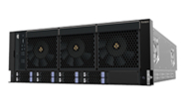
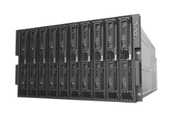
Sugon Server Family
TC6600
“新常态”
Reliability
High density Server
I980
TC5600
I620-G20
Mission Critical Server
速度
结构
动力
I840-G25
I420-G20
TC4600E
I620-G15
Rack Server
“信息产业”
I840-G20
A620-G
发展前沿
I620-G10
A420-G
转型支撑
A840-G10
I420-G10
I610-G20
Customize Server
新常态下扮演重要角色
创新牵引
I820-G10
I610-G10
I840-G10
I410-G20
I410-G10
I620-G12
I210-G30
I210-G20
I610-G12
Scalability

Slide 5
Agenda
1
Product Line Overview
2
2 Way Rack Servers
3
Mission Critical Servers
4
Personalize Services
Notes:
先讲整个IT行业的大背景

Slide 6
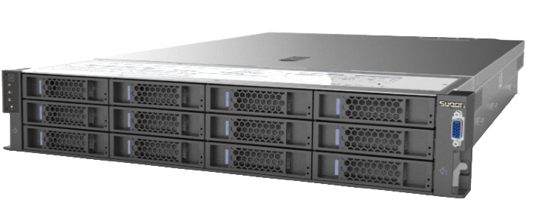
2 Way Rack Servers
Features
Modular design, on-demand customization;
Using the latest V3 E5 processor, performance increases 25%;
Maximum 28 hot-swappable 2.5 inch disc, the industry's highest specifications;
Network adapters free combination
Maximum 8 PCI-E expansion, the industry's highest specifications;
Performance optimization;
Star light diagnostics, LCD monitor screen, SD storage, second level positioning fault;
Redundancy design of key parts, 99.99% reliability.
I620-G20 SPEC JVM
World No.1！

Slide 7
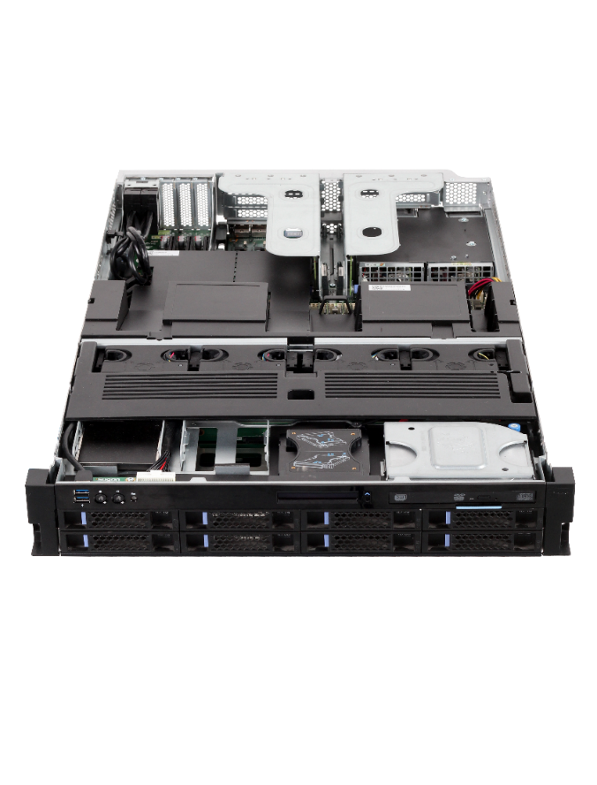
Module Design
Computing
CPU/Memory
PICE Extention
Up to 8 slots
Back Storage
4 extra HDD
Back I/O Module
Management
Redundant Fans
Hot plut N+1
Front Storage
8/12/16/24 HDD Bays
Power Module
Platinum, 1+1 Redundant
I/O Extention
Network/Storage

Slide 8
Various of Configurations
Storage
8+4（Back）
12+2（Back)
16+2（Back)
24+2（Back)
Network
2-port GbE
4-port 10GbE
2-port 10GbE
2-port 10GbE
SPF+
expansion
8*PCI E
2* GPU
5*PCI E

Slide 9
Intel 2U 2-way Rack Server
 | I620-G20 | I420-G20
Processor | 2*E5-2600 V3 | 2*E5-2600 V3, up to 105W
Memory | 24*DDR4, up to 1.5TB | 8*DDR4, up to 512GB
HDD Controllor | Onboard, 8*SATA2.0, 12Gb SAS RAID Controller | Onboard, 8*SATA2.0, 12Gb SAS RAID Controller
I/O expansion | Up to 8* PCIe 3.0 Support full-size GPU | Up to 8*PCIe 3.0
HDD Bays | 8/12*3.5” Hot-swappable 8/12/16/24*2.5”Hot-swappable Back pannel 4*2.5“ Hot-swappable | 8/12*3.5” Hot-swappable 8/12/16/24*2.5”Hot-swappable Back pannel 4*2.5“ Hot-swappable
NIC | Optional, GbE/10 GbE/RJ 45/SPF+/2-port/4-port | Optional, GbE/10 GbE/RJ 45/SPF+/2-port/4-port
Managem-ent | IPMI and KVM over IP, embedded management software based on web interface
8 HDD Bays
12 HDD Bays
16 HDD Bays
24 HDD Bays

Slide 10
AMD 2U 2-way Rack Servers
 | A620r-G | A420r-G
Processor | AMD Opteron 6300 series, 8/12/16 cores | AMD Opteron 4300 series, 6/8 cores
Memory | 16*ECC DDR3 DIMM，up to 256GB | 8*ECC DDR3 DIMM Up to 64GB
I/O expansion | 4* PCIe 2.0 1* 32bit PCI 1* special for storage | 4* PCIe 2.0 3* 32bit PCI 1* special for storage
HDD Controllor | Onboard SAS 2.0 controllor， 12* 2.5/3.5”HDD, Hot-swappable Up to 24*2.5”HDD； | Onboard SATA Host Raid0/1/5/10; 8/12* 3.5/2.5”HDD Hot-swappable
NIC | Integrated 2-port RJ45 GbE | Integrated 2-port RJ45 GbE
Managem-ent | IPMI and KVM over IP, embedded management software based on web interface

Slide 11
1U 2-way Rack Servers
 | I610-G20 | I410-G20
Processor | 2*E5-2600 , 105W以下 | 2*E5-2600 V3, 105W以下
Memory | 24*DDR4, up to 1.5TB | 8*DDR4, up to 512GB
I/O expansion | up to 2* PCIe 3.0 | up to 2* PCIe 3.0
HDD Controller | Onboard 8*SATA 2.0 Optional 12Gb SAS RAID Controller | Onboard 8*SATA 2.0 Optional 12Gb SAS RAID Controller
HDD Bays | 4* 3.5”Hot-swappable 8* 2.5” Hot-swappable | 4* 3.5” Hot-swappable 8* 2.5” Hot-swappable
NIC | Optional, GbE/10 GbE/RJ 45/SPF+/2-port/4-port | Optional, GbE/10 GbE/RJ 45/SPF+/2-port/4-port
Manage-ment | IPMI and KVM over IP, embedded management software based on web interface
4 HDD Bays
8 HDD Bays

Slide 12
2-way Server
Parameters
24DIMM, the highest
configuration in 2-way
Maximum 8 PCIe slots
4 2.5 backpanel HDD
Integrated SD slots,
Expand the storage
Capacity of BMC log
Support NV DIMM,
Sweep out other
venders
LCD Monitor,
Star light diagnosis
Integrated SAS Card,
SAS RAID, add
Other venders cost
Optional 2/4/8-port
GbE, 2/4 port 10GbE,
Not occupy PCI slots,
add other venders cost

Slide 13
Agenda
1
Product Line Overview
2
2 Way Rack Servers
3
Mission Critical Servers
4
Personalize Services
Notes:
先讲整个IT行业的大背景

Slide 14
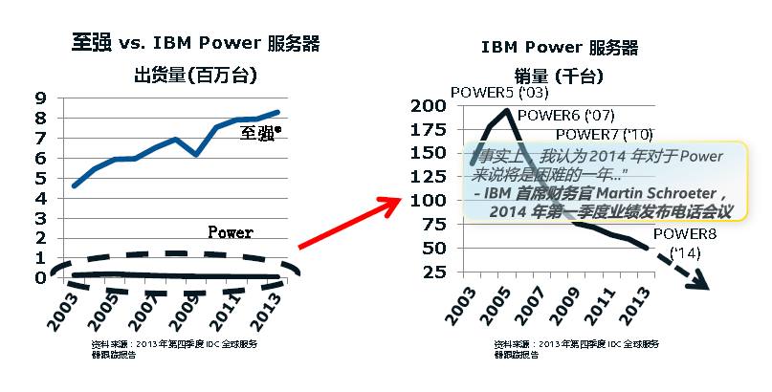
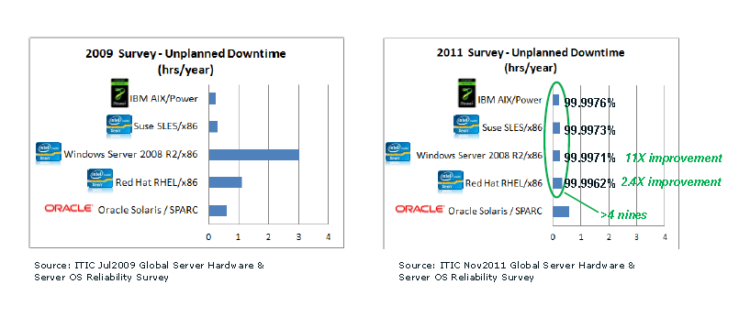
Selection of Customers and Market
X86 is continuous increase, Power is fading
Performance is equal to Unix server
It is the time
X86 solutions reduce total TCO
Mission Critical Task is switch to X86

Slide 15
The Platform Choice of Virtualization
Server Consolidation
Large 20+:1 virtualization projects while maintaining peak load application responsiveness
Lowest Server Count
Memory- and I/O-Intensive
Less Predictable Workloads Headroom For Peak Demand
Xeon E54600
E74800/8800
Powerful, expandable 4P+ servers designed to handle any virtualization project with ease, especially when >24GB memory, intensive I/O, or server reliability are critical considerations
Infrastructure Virtualization
Small to medium-sized consolidation, typically ranging from 8-16:1 of infrastructure apps
Raise Server Utilization
Small Infrastructure Apps
Predictable, Stable Workloads
E5 2600
Two-socket licensing, excellent price/performance/Watt with quad-core technology on Intel® Core™ microarchitecture make these servers ideal for smaller IT virtualization projects

Slide 16
4-way Mission Critical Servers
19.7%
17.8%
14.3%
15.8%
No.1 demostic venders in Marketing share
No.1 in the increase of marketing share（168.7%）
Solution of Unix to Linux ( U2L)
Server Vertualization/Cloud Solution
IDC 2014 Q3 Report

Slide 17
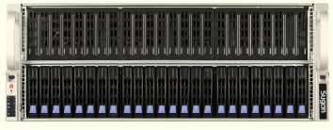
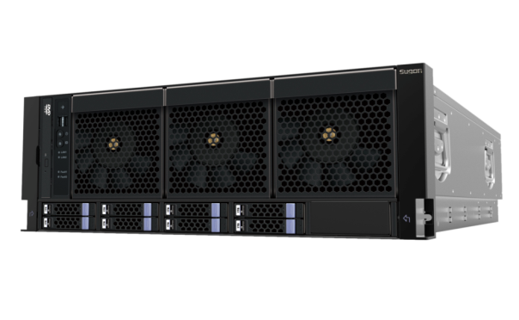
4-way Servers Summary
 | I840-G25 | A840-G10
Processor | 4*E7-4800 V2 | 4*AMD Opteron 6200 /6300
Memory | 96*DIMM，up to 6TB | 32 *DIMM, up to 1TB
HDD Controller | SAS, SAS RAID Card | Integrated 8 *6Gbps SAS RAID 2.0 Controller， RAID 0/1/10/5/6/50/60
I/O expansion | 11*PCI-E Slots; 4个PCI-E3.0 x16 7个PCI-E3.0 x8 | 2 *PCI-E2.0 x16 2 *PCI-E2.0 X8
HDD Bays | Up to 24*2.5”SATA/SAS/SSD | Up to 8 * Hot-swappable 2.5”SAS /SATA
NIC | Dual ports 10 GbE Base-T RJ45 | 4* 1GbE RJ-45 1* 1GbE RJ-45
Management | IPMI, KVM over IP, embedded management software based on web interface

Slide 18
4-way Server Competitive Analysis
Try to avoid talking with the customer pre-VGA, USB and built-in DVD quantity
Model | SUGON I840-G25 | Lenovo RQ940 | Inspur NF8480M3 | Huawei RH5885H V3 | IBM x3850 X6 | HP DL580 G8 | Dell R920
Height | 4U | 4U | 4U | 4U | 4U | 4U | 4U
DIMM | 96 | 96 | 96 | 96 | 96 | 96 | 96
HDD | 24*2.5” | Maximum 12*2.5” | 8* 2.5” | 8 or 23* 2.5” | 8* 2.5” 16* 1.8”eXFlash | 10* 2.5” | 24* 2.5”
PCI-E | 11 PCIe 3.0 | 10 PCIe3.0 | 12 PCIe 3.0 | Maximum 16 PCIe | 11 PCIe | 9 PCIe | 10 PCIe
Network | 2-port 10GbE | 4-port GbE/ 2-port 10GbE | 4-port GbE, Optional 2-port 10bGbE | 2-port GbE/ 4-port GbE/ 2-port 10GbE | 4-port GbE/ 2-port 10GbE | 4-port GbE/ 2-port 10GbE | 4* GbE/2-port GbE + 2-port 10GbE
Power Suppliment | 4x1620W | 4x1600W | 4 Power Suppliment | 2x2000/2x3000/2x2500 | 4x1500/4x900/4x750 | 4x1500W/4x1200W | 4x750W ,1100W

Slide 19
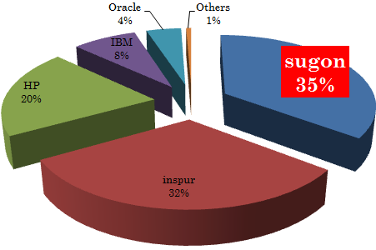
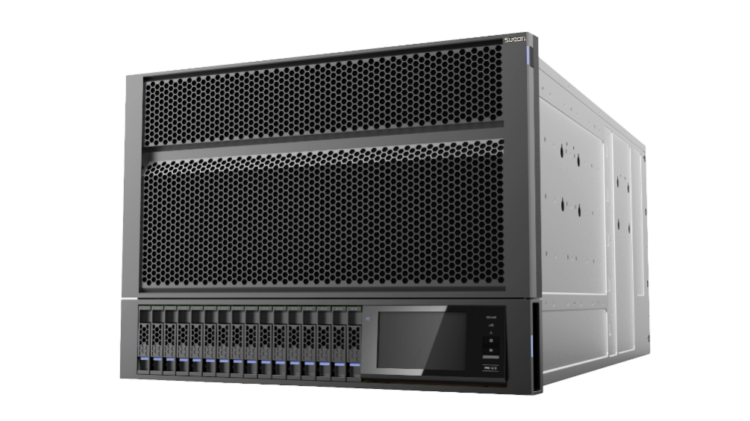
I980-G10 Rack Server Summary
14'Q2
PRC 8-way Marketing share
The first designer of 8-way Server in China
60+ RAS features, Full redundancy design
10+ World No.1 in SPEC test
No.1 in SPEC Power testing for China Telecom, 40% Over the follower in performance
No.1 in Performance testing of Database for China Mobile, Over IBM Power Platform
No.1 performance test for State Grid

Slide 20
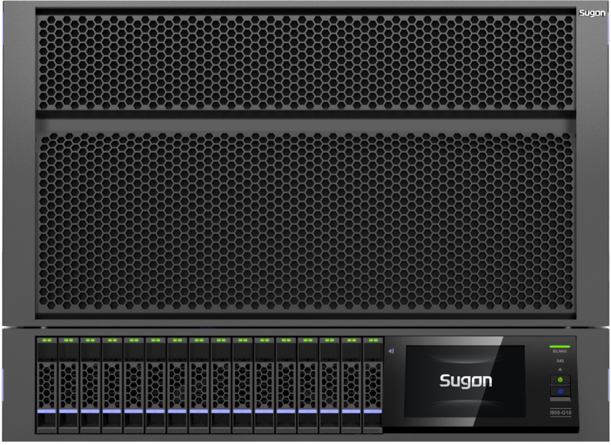
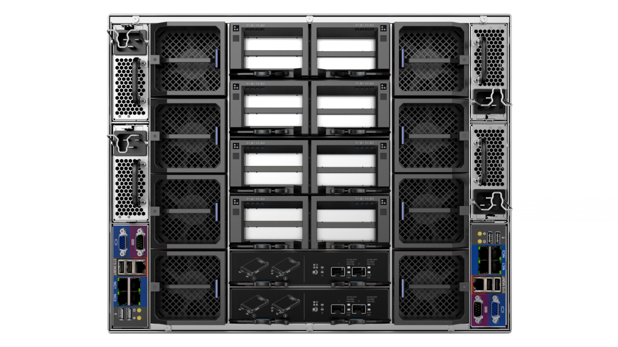
I980-G10 Specification
 | I980-G10
Processor | Up to 8 Intel® Xeon® E7-8800 V2 (Ivy Bridge EX),
Memory | Up to 128 Reg. DIMMs , ECC DDR3 is supported，UP to 8TB
PCI expansion | 16 PCIe x8 slots, Up to 4 PCIe x16, Full-size expansion card is support
Storage | Up to 16 2.5-inch hot-swap bays ( SATA/SAS/SSD )
Network | Integrated 4* 1Gb Ethernet ports, optional 2 SPF+ 10GbE ports
Systems management | IPMI, KVM over IP, embedded management software based on web interface
Fan | The intelligent fan
Power supply | 4 hot-swap high efficiency 2000w redundant power supply , redundant mode 1+1, 1+2, 2+2, 3+1
Form factor | 8U rack

Slide 21
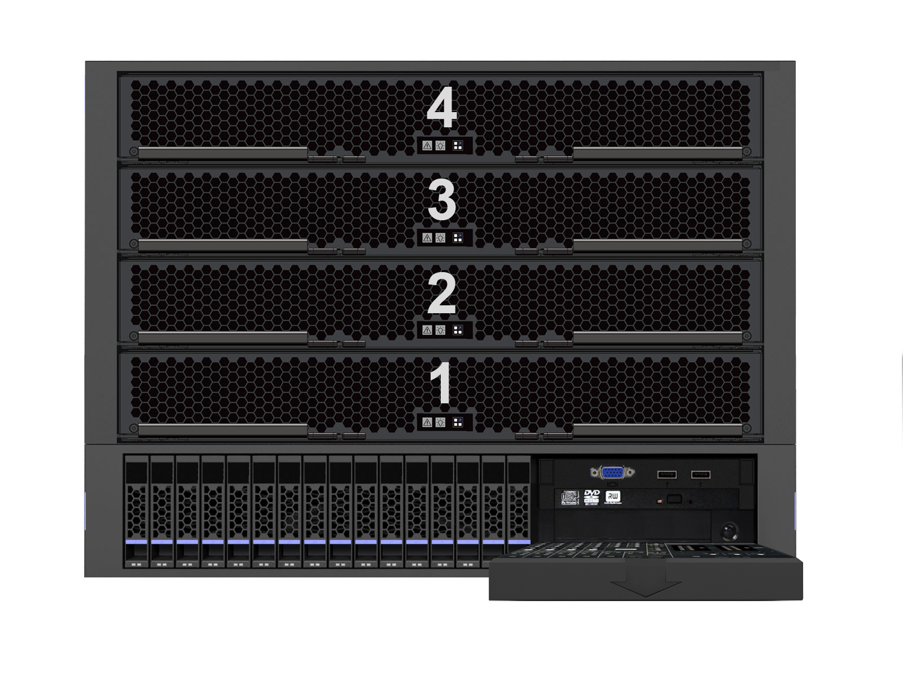
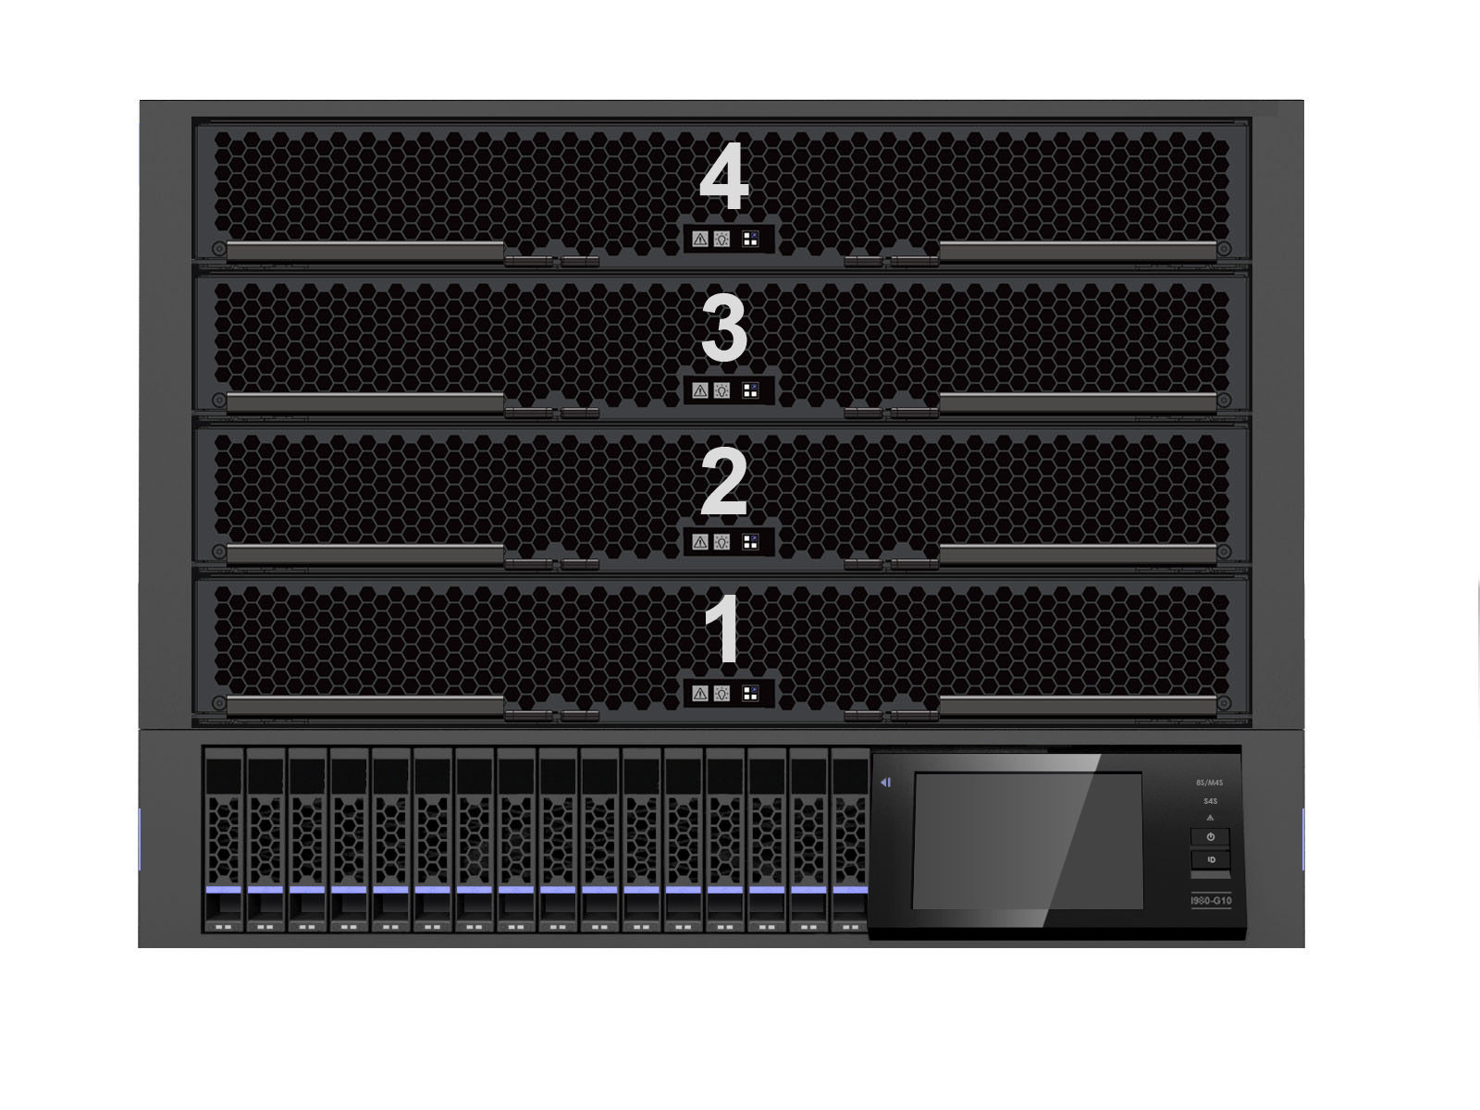
I980-G10 Front Panel
Motherboard
Group
[1、3]
[2、4]
VGA
USB
DVD
Tape (Optional）
Storage Module, Up to 16* 2.5’HDD
Touch Monitor Screen

Slide 22
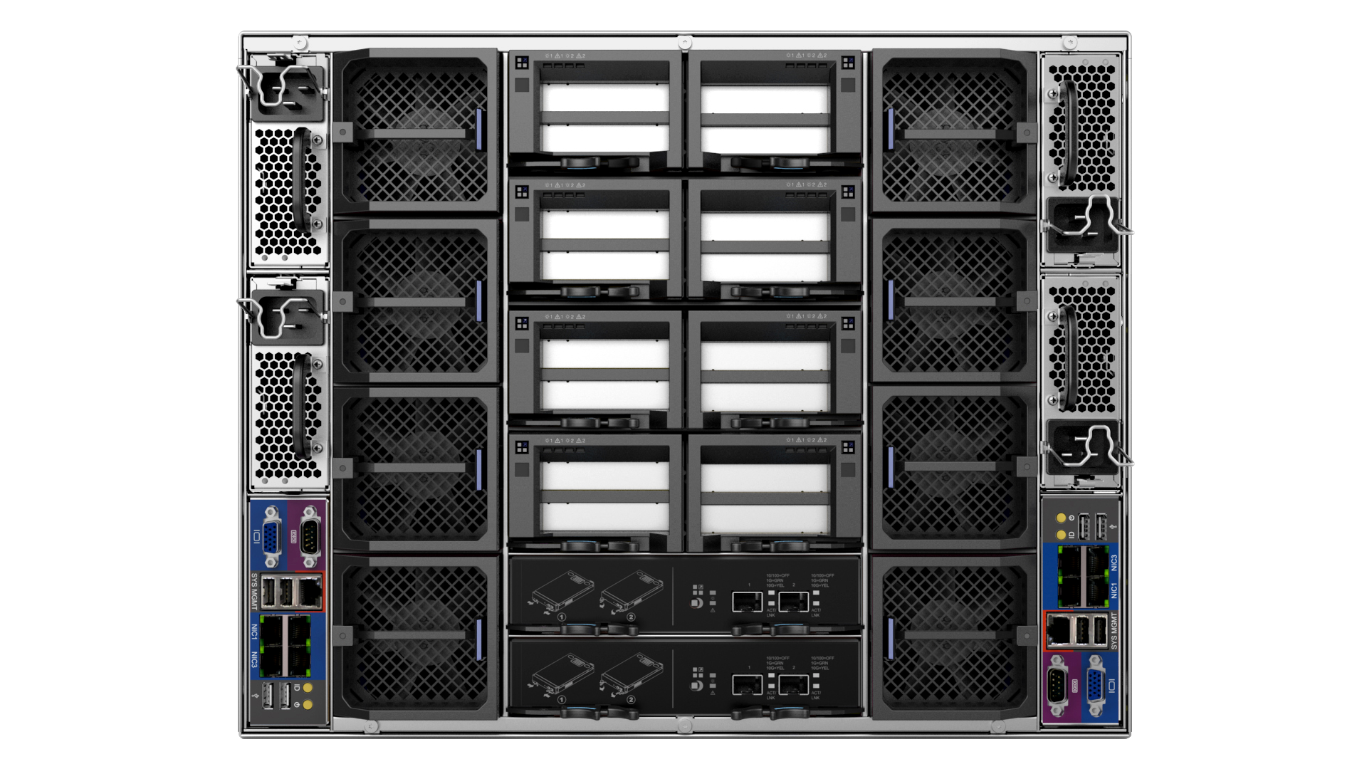
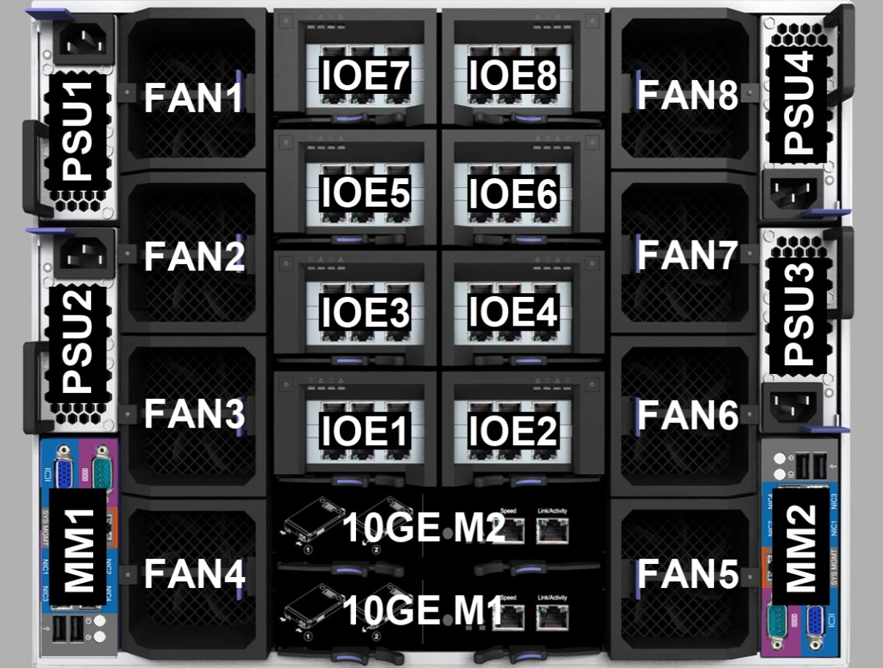
I980-G10 Back Panel
Hot-swappable IOE Module；
Support 16* X8 /4* X16 PCI-E Cards,
Support GPU
Power Module；
4* 2000W
2+1, 3+1, 2+2 Redundant Mode
Up to 8 hot swap redundant fan
Management
VGA Serial Port, 4* GbE/
4* USB 2.0
Dual ports 10 GbE SFP

Slide 23
I980-G10 Technical Features
Hardware Partition
optical diagnosis
Redundancy
Easy switch between 8-way or 2*4 way
Independent expansion of core components
Fast locate the failures
On-site monitoring
First usage in 8-way
All parts can Hot-swappable
Support PCIE/Fans/Power/CPU module Hot-swappable
Touch Monitor
Fast video
mSATA
Green
Full perspective
The most complete state monitoring
Identity authentication
post 80 code
Fast Locate
Inner 2*mSATA HDD
Use as sysem HDD
Upgrade 30% storage volumn

Slide 24
8-way Server Competitive Analysis
 | Sugon I980-G10 | Inspur TS860 | Huawei RH8100 V3 | IBM x3950 X6 | Comments
DIMM | 128 | 192 | 192 | 192 | More than 64 other manufacturers, the maximum frequency can only go to 1333MHz, I980-G10 is able to run to 1600MHz, eight-way servers to maximize performance guarantee
HDD | Maximum 16 2.5”SAS/SATA/SSD Optional 2 internal mSATA SSD | Maximum 16 2.5”SAS/SATA/SSD Optional 2 internal mSATA SSD (maximum 4) | 12/24 2.5”HDD SAS/SATA/SSD | Maximum 16* 2.5”HDD, Or maximum 32* 1.8” 400GB eXFlash SSD | Built-in support for mSATA SSD hard drive only Inspur, but IBM and Huawei can support eXFlash SSD
PCI-E | Full hot-plug 16 PCIe slots, PCIe 3.0 x8, include 4* PCIe 3.0 x16 | 26 PCIe 3.0 slots, 12 PCIe 3.0 x16, 14 PCIe 3.0 x8 ( 2 slots only for RAID card) | Maximum 16 PCIe slots | Maximum 22 PCIe slots | No venders can support 16 hot-plug slots
Network | Integrated Intel I350 4-port GbE, Optional 1/2 2-port 10GbE without PCI slots | Integrated 4-port GbE | Optional 1/2 GbE/10 GbE network module | Integrated 4-port GbE/ 2-port 10GbE | Other venders have to use PCI slot to support 10GbE module
Power Suppliment | 4 modules, 2000W，N+N Redundant | Maximum 8* 800W modules | 4 modules, 2+2 Redundant, Optional 2000W/3000W AC or 2500W DC | 8个750W（DC）/900W(AC)/1400W (AC) N+N modules | Beat IBM & Inspur, IBM and Inpur use eight power modules, not only increase energy consumption also increased the point of failure
Management | 4.3-inch touchable LCD monitor screen | optical diagnosis Screen, small LCD | Integrated touchable LCD monitor screen | optical diagnosis | Independ Technology
Online Maintenance | All modules can maintained from front or rare without tools | Parts of | Unknown | Support | Fans, PCIe are not supported uninterruptible maintenance

Slide 25
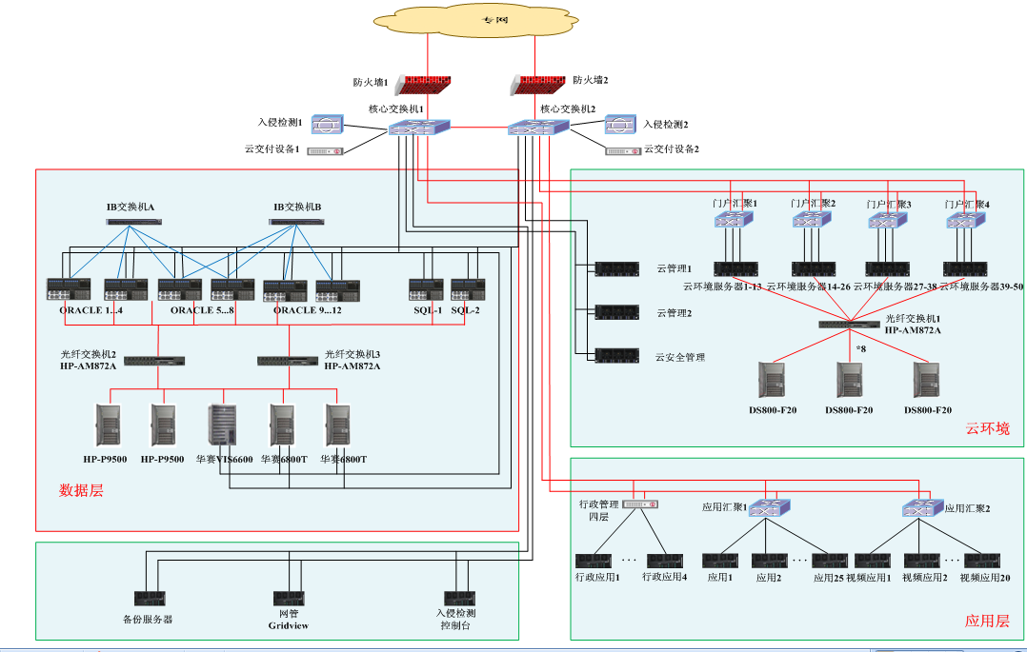
U2L Successful Story: Xinjiang Public Security

Slide 26
Xinjiang Public Security Cloud
First public Security Cloud
First Big Data Analysis Platform of Full Social Security Data
Statistic
Trend
Dispatch
Query
Tracking
Face Rec.
Image
Public Security Data Platform
Unique interface of Data Access Service
Integrated
Query
Special Topic
Full Contents
Multimedia DB
Fusion Data Platform
Category
DB
Social
Inform.
Collabor-ation
Internet
DB
Multimedia

Slide 27
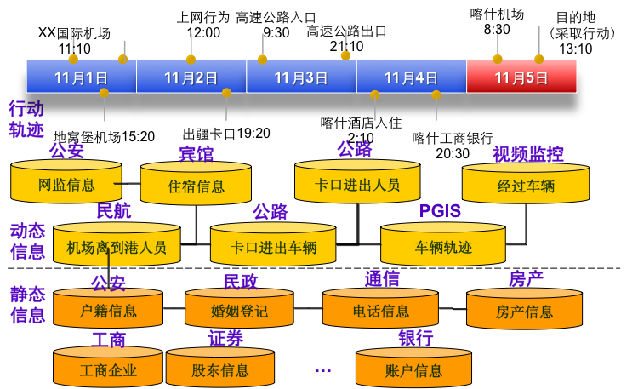
Xinjiang Public Security Cloud
Highway
Entrance
Surfing
Kashi Airport
Destination
(Action)
Urumqi Airport
Highway Exit
Track
Info.
Dyna.
Info.
Static
Info.

Slide 28
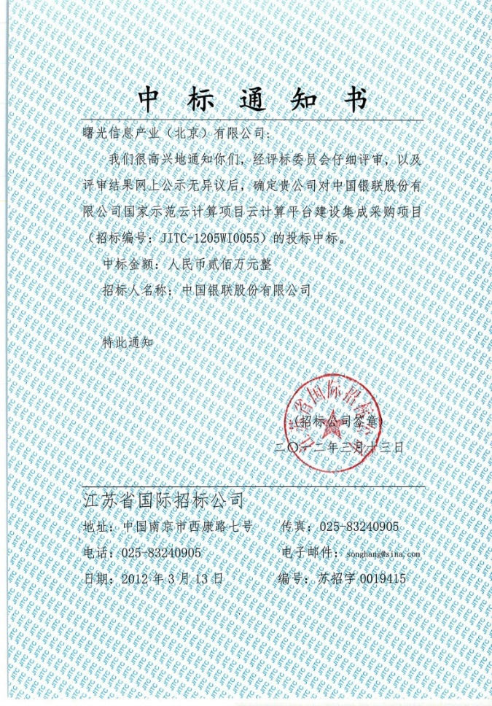
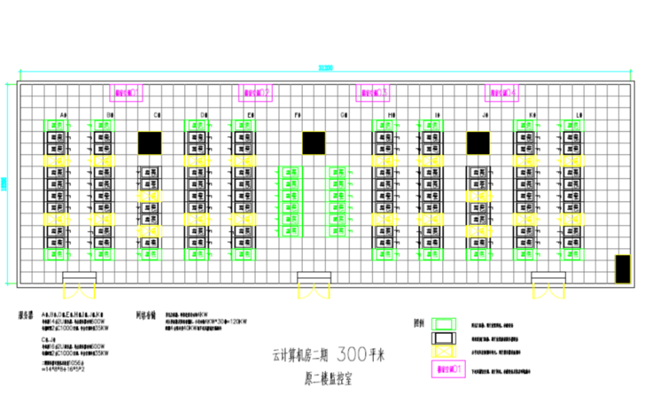
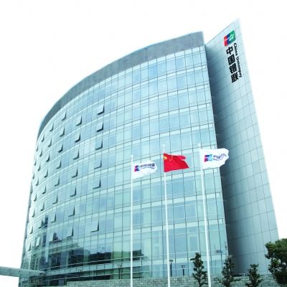
China UnionPay Cloud
System Architecture Consultant, Integrator
Deployed over 3000 Servers
Win Announcement
Notes:
UnionPay, established in 2002, is the national bankcard association in China. With its pivotal role in China’s bankcard industry, UnionPay is responsible for operating the unified inter-bank clearing and settlement system in China and developing the international acceptance network for UnionPay cards.
To date, the total number of UnionPay cards issued worldwide has exceeded 2.1 billion; in 2009, the number of UnionPay card inter-bank transactions reached 7 billion totaling USD 1.1 trillion; the number of merchants, POS terminals and ATMs reached 2.13 million, 2.88 million and 930 thousand respectively. UnionPay has also established partnerships with around 400 financial institutions all over the world.
48

Slide 29
Agenda
1
Product Line Overview
2
2-way Rack Servers
3
Mission Critical Servers
4
Personalize Services
Notes:
先讲整个IT行业的大背景

Slide 30
Personalize Service
Logo
Appearance & Arch.
According to customers’ requirements products customized, including product specifications, server internal structure, product appearance.
Logo customization for packaging, labeling, BIOS and BMC interface.
Simple
According to customer business features, using products for the overall customization, improve the system TCO.
Customized functions of BMC chip, BIOS, etc.
Complex
Solution
Function

Slide 31
Main Personalization & OEM Customers

